Slide 1
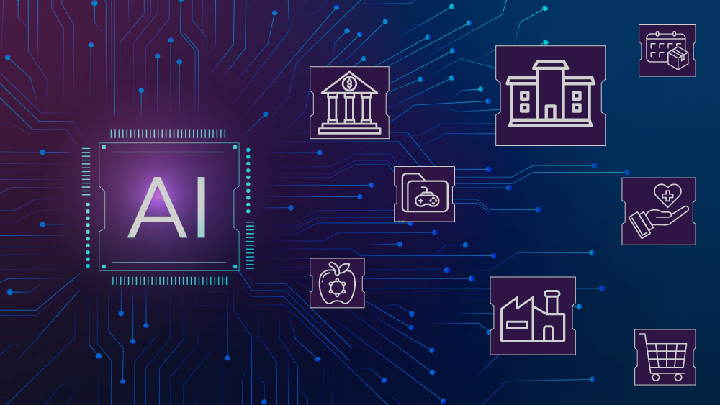
Uncovering Impact of AI on Jobs and Industries
Author: Aashish Singh
Dated: Aug 2024
(for NLP - Final Project)

Slide 2
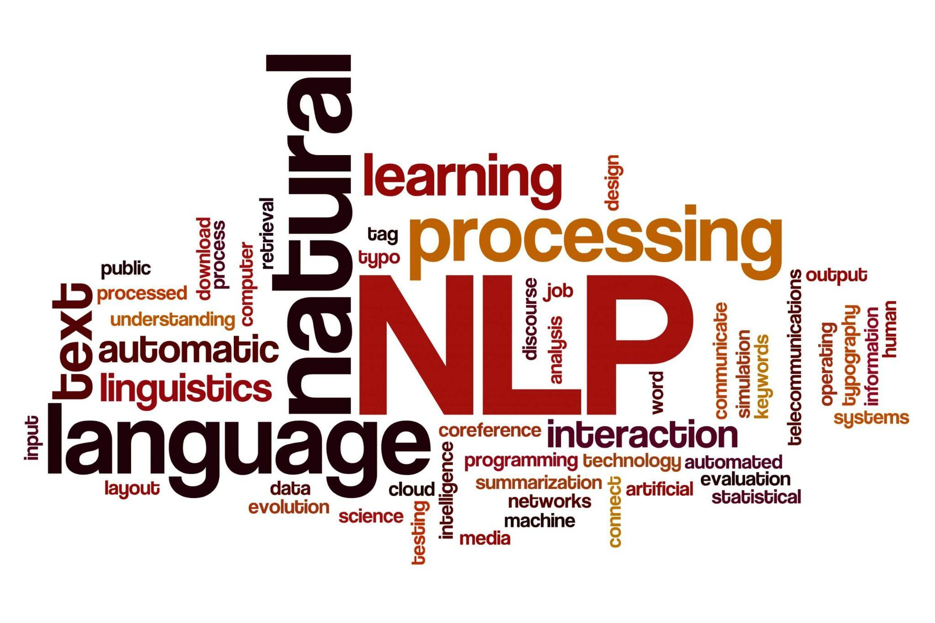
Agenda
Executive Summary
Actionable Recommendations
Data Overview
Article Clean Up, Text Processing, & Filtering
Exploratory Data Analysis (EDA)
Topic Detection
Sentiment Analysis
Time Series Analysis
Positive / Negative Sentiment across Industries
Entity Identification
Targeted Sentiment Analysis

Slide 3
Executive Summary
Executive Summary
Problem Statement: The objective of the final project was to identify what types of jobs / industries are most likely to see a big impact from AI and to gather extracting meaningful insights from unstructured text provided to us.
Insights:
Industries with positive sentiment articles and investing in AI
Semiconductor: Chip-makers like ‘NVIDIA’ and ‘TSMC’ saw a huge uptick in article mentions as the need for AI chips rose in last 2 years which was witnessed in the stock surges. They will continue high investment in AI and improving productivity through better chips.
Technology: Technology companies like ‘Google’, ‘Microsoft’, ‘OpenAI’ have always had AI articles with positive sentiment but it surged from 2023 after introduction of ‘ChatGPT’ and transformed the technology industry to aggressively invest in AI. However to continue heavy investment in AI these companies also had layoffs and struggled with negative sentiment articles around those.
Finance: Finance companies were ecstatic with the surges in AI companies and stock trades, we saw a lot of articles discussing price, earnings, nasdaq leading to what’s know as AI bubble. Separately they are also using AI for high volume stock trading thus invested in AI.
Healthcare: Healthcare industry saw positive sentiment around AI support in patient care, early cancer detection and streamlining claims process but some voiced negative sentiment around denial of insurance claims.
Industries with negative sentiment articles and concerned about AI
Government: Government agencies voiced negative sentiment as they grappled with the challenges in regulating AI and concerns about surveillance, job displacement, and ethical implications of AI which have led them to take critical stance on AI’s rapid advancement.
Legal: Legal industry is concerned about the potential disruption AI could cause with negative sentiment around AI replacing certain legal jobs, such as paralegals or contracts, and fears about the accuracy and fairness of AI in legal decisions.
Academic Institutions: Academic institutions are experiencing negative sentiment due to the fear of AI disrupting traditional education models with concerns about AI replacing educators, plagiarism, and the challenge of keeping curricula up to date.
Social Media: Social media companies have seen a surge in negative sentiment articles due to AI’s role in misinformation, deep-fakes, manipulation of public opinion. It is critical for them to get this right else will lead to disruption in current operating model.
Overall, US lead engagement in AI related topics with India close 2nd and China 3rd, Taiwan had negative sentiment due to chip making dependency on them and Israel due to its use of AI in recent wars. Politicians voiced negative sentiment around AI and technology evangelist continued to voice positively about AI.

Slide 4
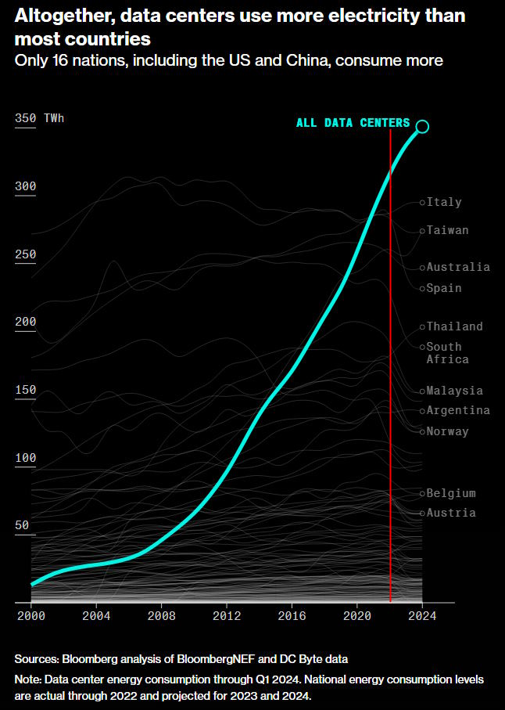
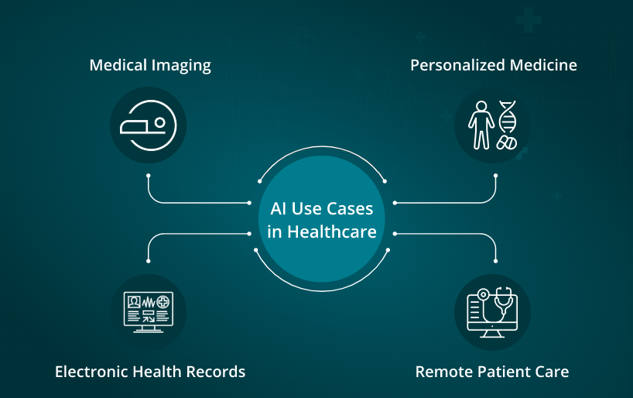
Actionable Recommendations
Actionable Recommendations
Goal: To provide actionable recommendations on what can be done with AI to automate the jobs and / or improve employee productivity
Recommendations:
Invest in Energy Efficient AI Chipsets: Invest and develop energy-efficient AI chipsets to support the growing computation without exacerbating climate change. This is vital as AI emergence is putting a lot of pressure on our energy grids and water supply.
Enhance Patient Care with AI Diagnostics: Implement AI-driven diagnostic tools in healthcare to enable real-time analysis and early detection of diseases like cancer. Focus on integrating AI with EHR to streamline administrative tasks. However, we need to ensure fairness and transparency to avoid biases in decision making.
Enhance AI Cybersecurity: Enhance cybersecurity protocols by integrating AI with cloud platforms to detect and mitigate threats in real-time. This is crucial as AI-driven systems become targets for cyber-attacks, especially in government and finance sectors.
Combat Fake News with AI: Implement AI systems to monitor and analyze the spread of information across platforms, identifying and mitigating the impact of fake news and misinformation to protect public discourse.
AI in High-Volume Stock Trading: Utilize AI algorithms in the finance sector to process large volumes of data quickly, enabling the automation of trading decisions with enhanced accuracy and efficiency.

Slide 5
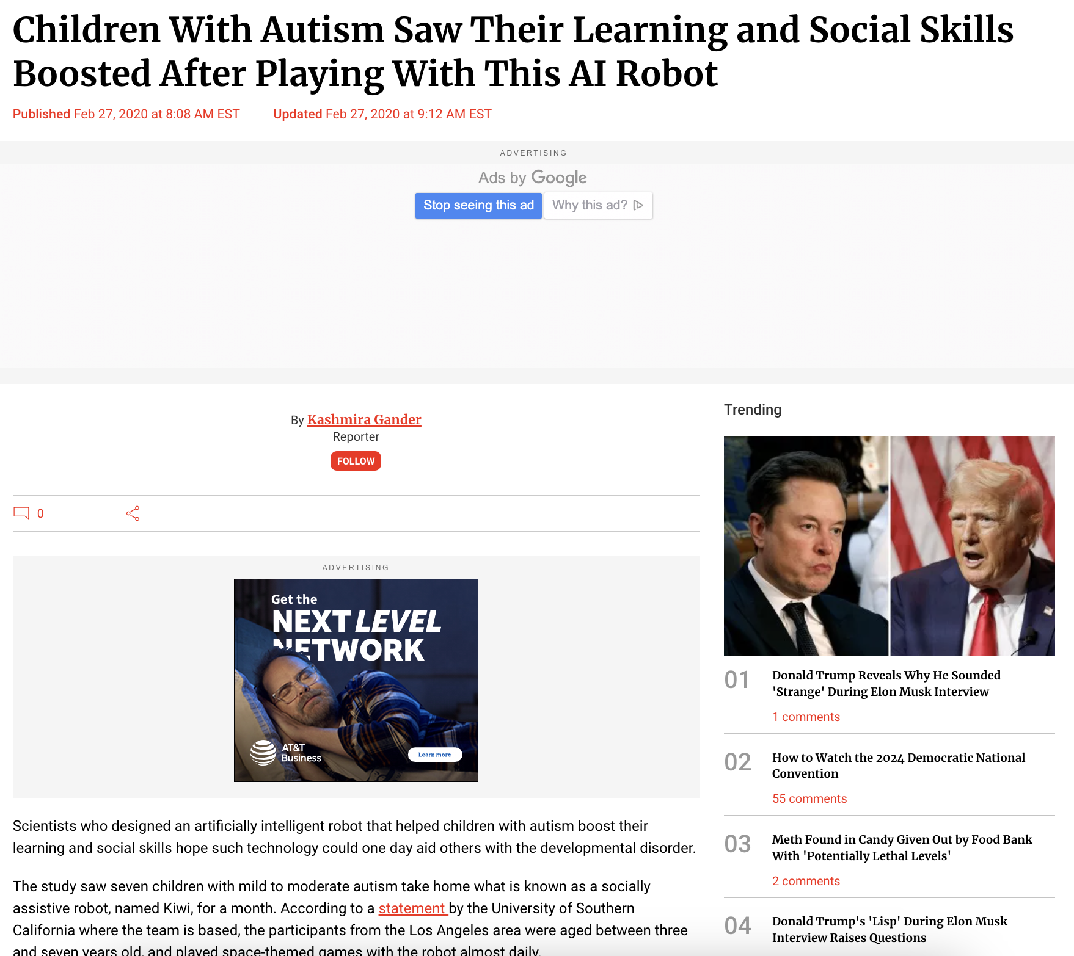
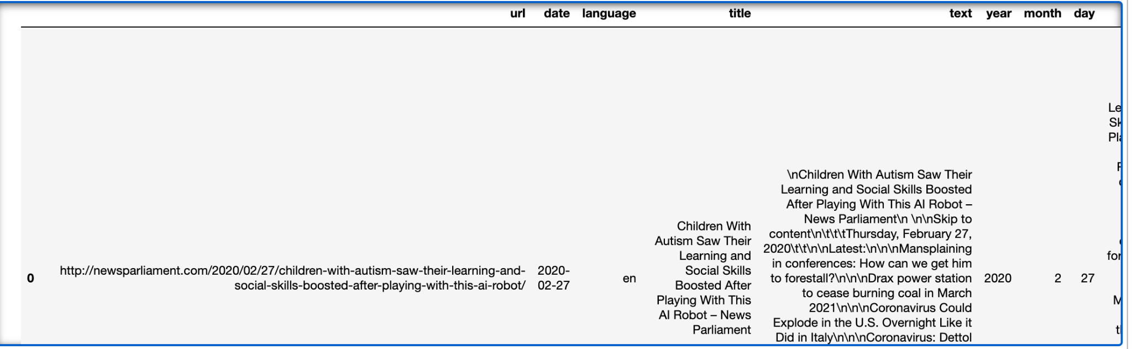
Article clean-up and filtering
200k articles provided to us were from Jan’20 to Jul’24 and were trimmed to 120k articles relevant to AI topics
Data Source Overview
Article Clean Up, Text Processing & Filtering
Article Clean Up
Kept only ‘en’ articles and eliminating newlines, tabs, HTML links (web crawls), emails, and other irrelevant text like emojis / special characters
~200k articles left
Text Processing
Lowercased words, removed stopwords, numbers, then tokenized and lemmatized words
~146k articles left
Filtering
Filtered articles to relevant topics like: AI, ML, Chatbots, LLMs etc
~120k articles left
Treatment
Further treated articles by removing articles with too less or too high of word count
@Data Source: https://storage.googleapis.com/msca-bdp-data-open/news_final_project/news_final_project.parquet

Slide 6
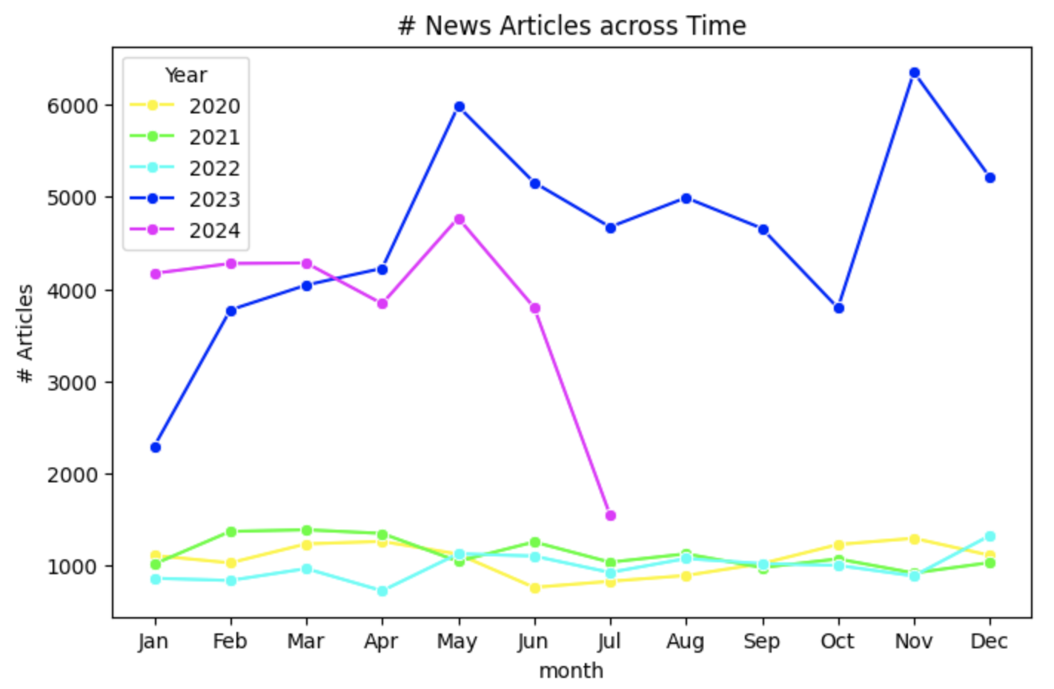
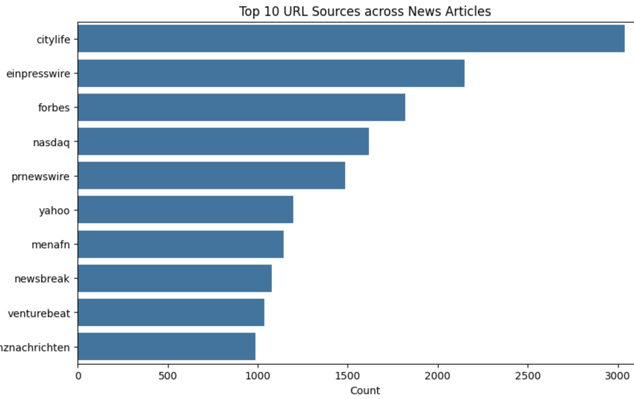
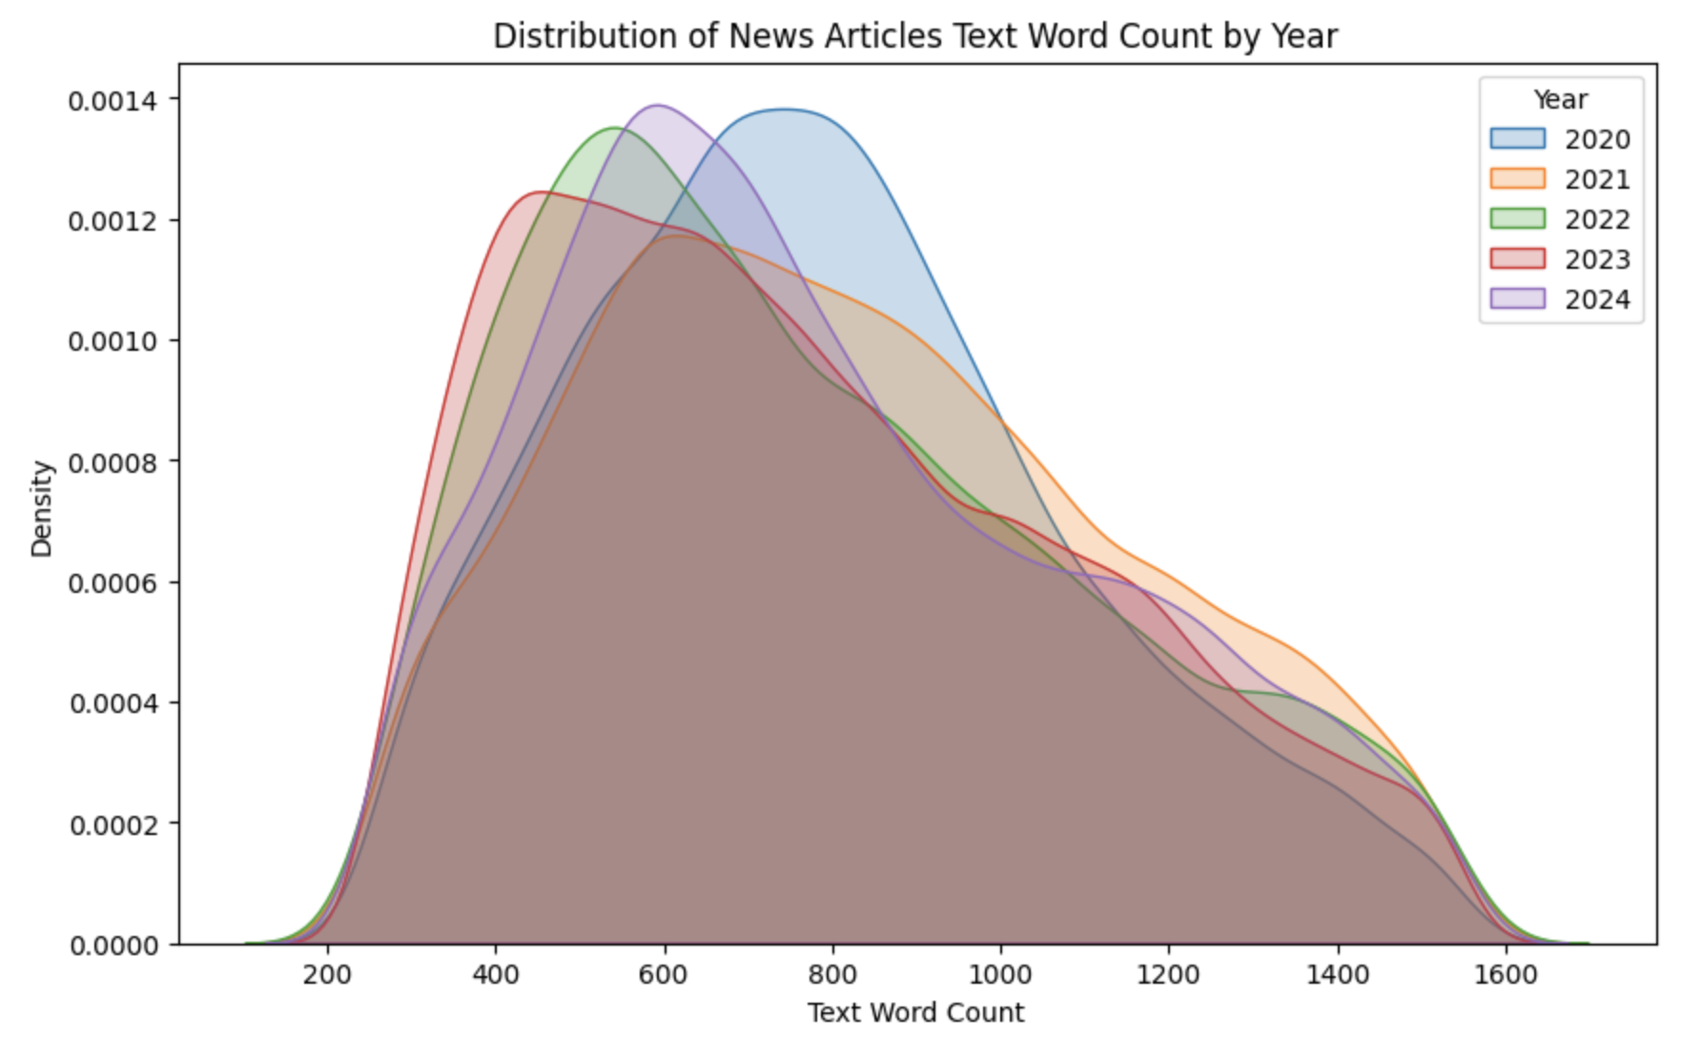
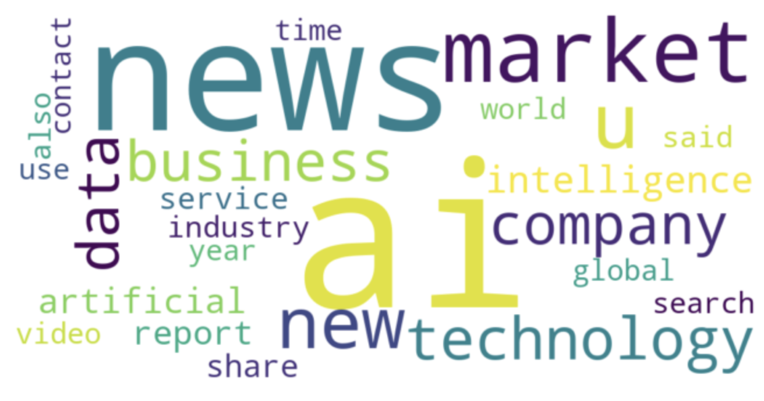
Exploratory Data Analysis
Filtered 120k articles were further explored segment wise
Filtered 120k articles were from Jan’20 to Jul’24 with increased volume from Nov’22 (ChatGPT launch) and has continued to grow with other AI launches
Articles are coming from ~5k press sources, but top famous sources include forbes, nasdaq, yahoo, newsbreak
Articles across time are normally distributed on word count but 2023 we see a left skew indicating a higher volume of shorter, quicker-read articles
From top word count cloud we can see that articles are concentrated in AI, technology, search, news, business, and market related terms

Slide 7
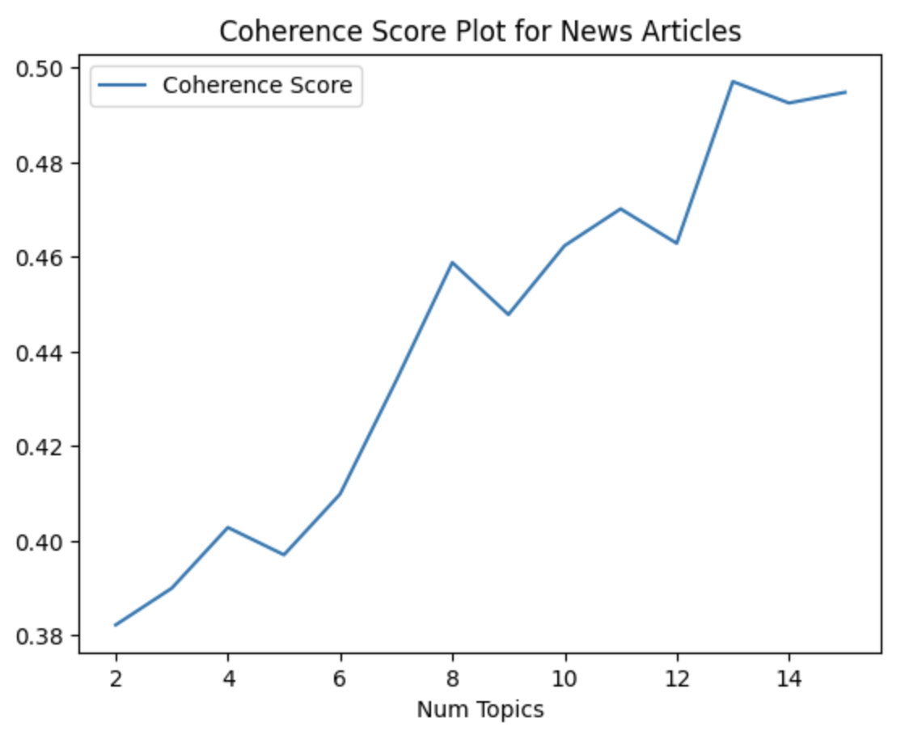
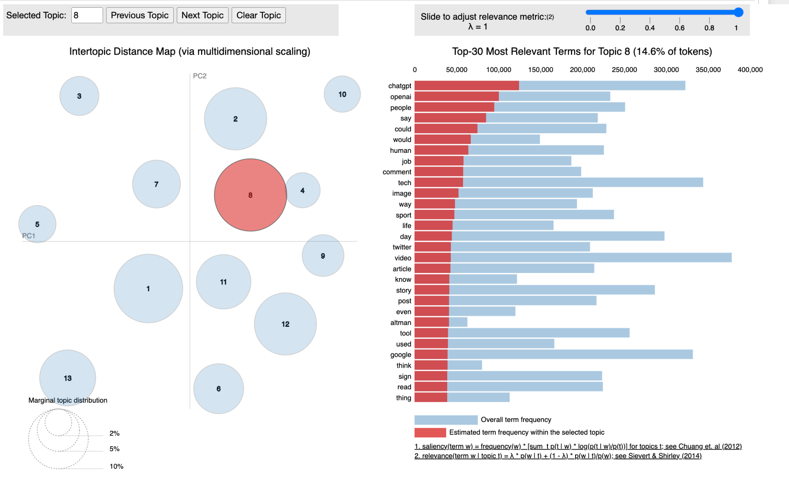
Topic Detection
Topic Modeling using LDA with Gensim identified 13 topics for best coherent score
Topic Modeling (using LDA with Gensim):
We used N=13 based on the coherence score peak shown above. The model was able to distinctive create topics as discussed in next slide
Model was tuned on best parameters based on coherence score with: N=13, Auto = ‘asymmetric’ and Beta = ‘auto’
It took almost 5 hours to run the model across all topics and we constrained to N=15 as max for that reason

Slide 8
Topic Detection
N=13 Topics Emerged from LDA Topic Model summarizing AI’s impact across different sectors
Related to Cybersecurity and Cloud Integration ¹: There is a significant focus on cybersecurity and AI, particularly with AI's integration into cloud platforms. This combination is enhancing threat detection and prevention, leading to more robust digital security.
Related to Time-Sensitive Content: AI is being used to tailor time-sensitive content such as real-time weather updates, top stories, and video highlights, making information more accessible and timely.
Related to region, month and releases
Related to Social Media and Music ^{1, 2}: AI is transforming how we interact with social media and music. AI-driven personalization is enhancing user experiences on platforms like Facebook and LinkedIn, while also revolutionizing the music industry with AI-generated content.
Related to Impact on Energy, Transportation, and Climate ^{1, 2, 3}: AI is driving innovation in energy and transportation, but the increasing computational demands are raising concerns about energy usage and climate impact. As AI becomes more integral to these industries, the need for sustainable practices is critical.
Related to Finance, Stock Market, and Chip Industry ^{1, 2}: AI is significantly impacting the stock market and the chip industry, with companies like NVIDIA experiencing record growth due to AI-driven demand. The chip industry is expected to see substantial investment as AI continues.
Related to AI involvement in India’s Government, Banking, and Elections ^{1, 2, 3}: In India, While AI is enhancing services in banking, there are growing concerns over its role in elections, particularly regarding misinformation and deep fakes
Related to OpenAI and ChatGPT and its impact on workforce ¹: The rise of AI and tools like ChatGPT is transforming the market, and while AI is making many tasks efficient, it also poses a risk to jobs, potentially leading to layoffs and shifts in job roles across various industries.
Related to Healthcare and Insurance ^{1, 2}: AI is revolutionizing healthcare by improving diagnostics and patient care. However, there are concerns about AI-driven biases, particularly in health insurance, where decisions made by algorithms may unfairly deny claims.
Related to Public Radio and Podcasts: AI is influencing the future of public radio and podcasts, sparking debates and discussions on its impact on media and local content creation.
Related to Learning and Research ¹: AI is being increasingly integrated into education and research, with universities striving to stay at the forefront of AI advancements to remain competitive
Related to Tech Giants - Google, Microsoft and Apple: The competition among these companies is intensifying as they ramp up their AI capabilities to maintain leadership in the tech industry. Google was caught off guard with ChatGPT adoption and has put significant effort in bridging the gap.
Related to Market, growth analysis, research, and forecast: AI is in its early stages, and a lot is dependent on forecast and growth analysis with different markets

Slide 9
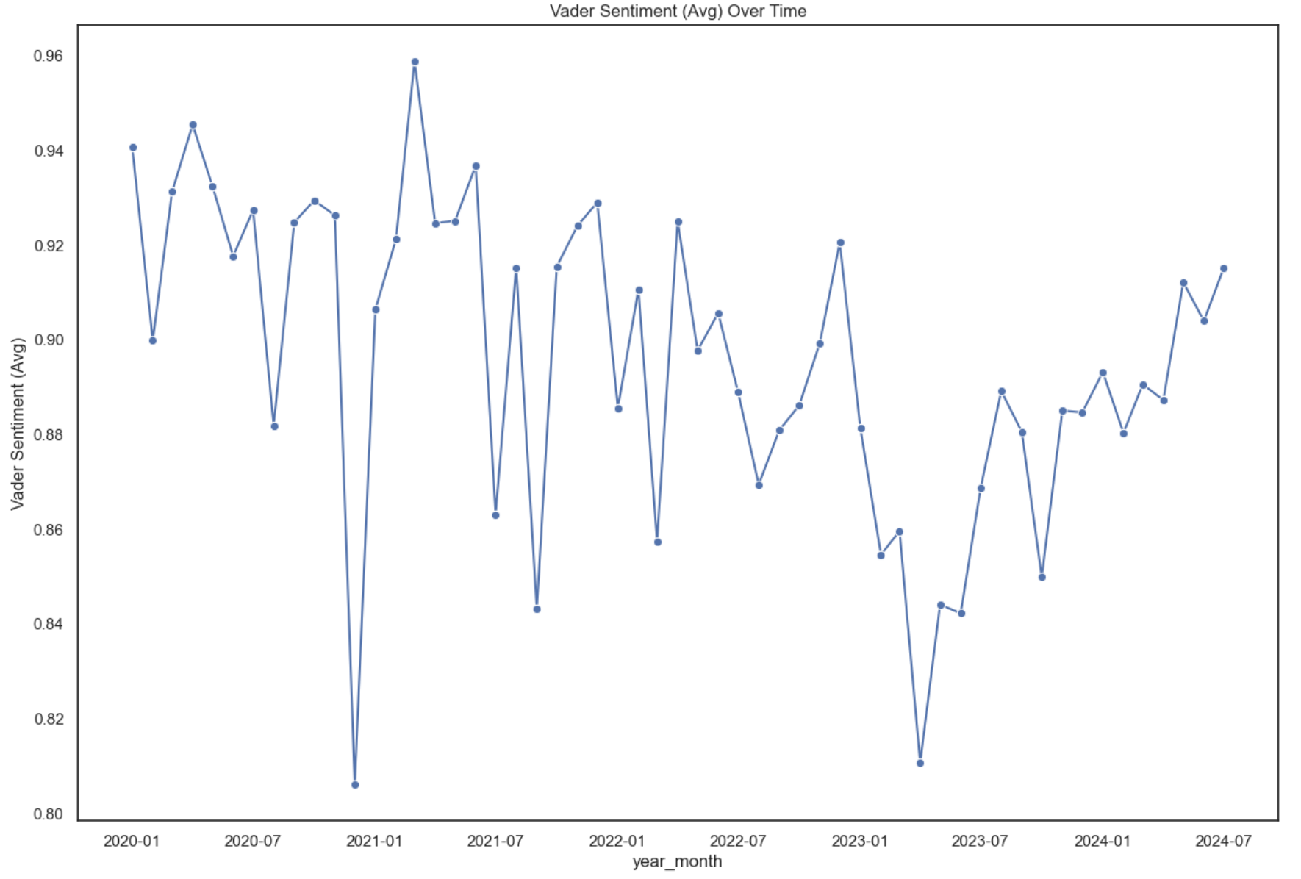
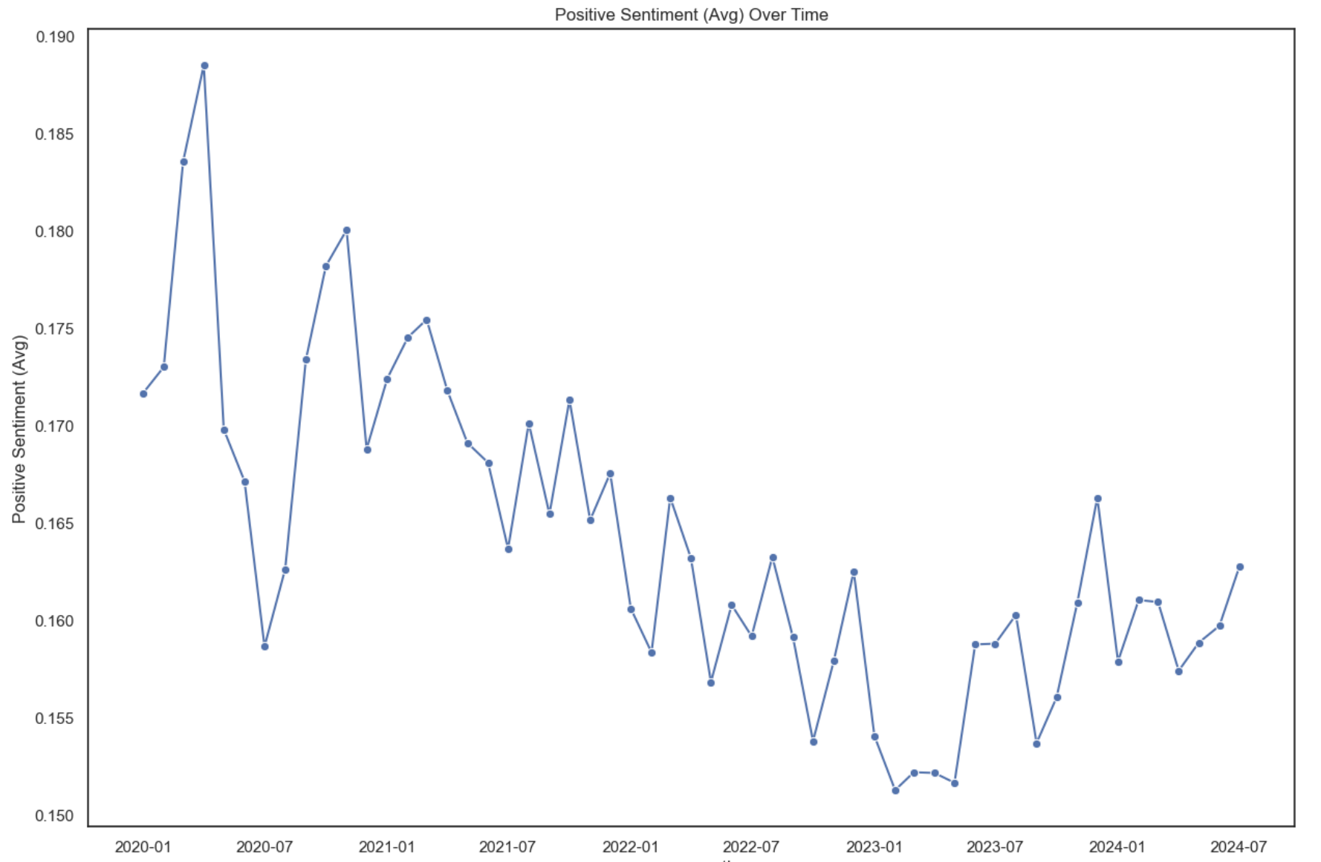
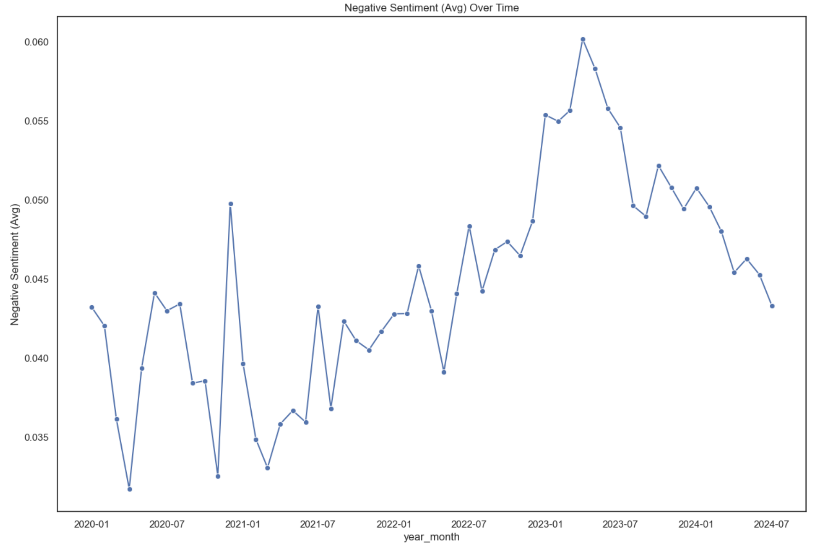
Sentiment Analysis
Sentiment Analysis using VADER shows a general positive sentiment for AI with small dips in between
Isolating the positive sentiment across articles over time we see that it’s declining likely due to fears of job displacement and misinformation
Sentiment Across Time: We see that overall compound sentiment is mostly positive with slight decline in mid-2023 likely due to bad launches, job displacement fears, AI generated content causing misinformation thus leading to a noticeable increase in concerns and criticisms. Since then it has improved with healthy discussion around regulations, responsible deployment and pullbacks.
Isolating the negative sentiment across articles over time we see that it’s risen significantly which lines with government stepping and citing concerns

Slide 10
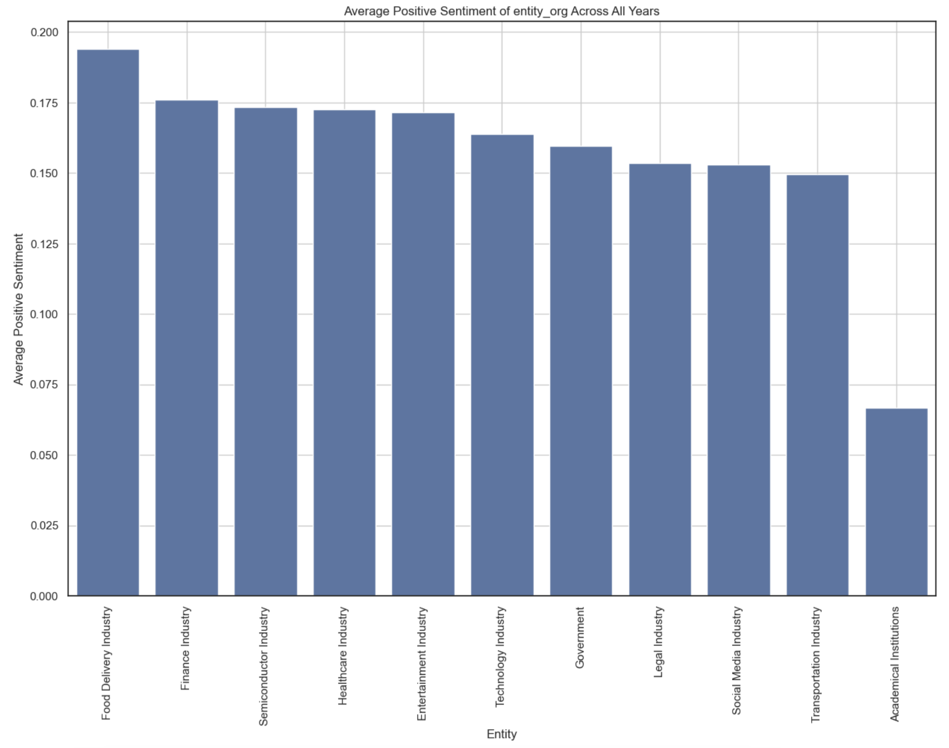
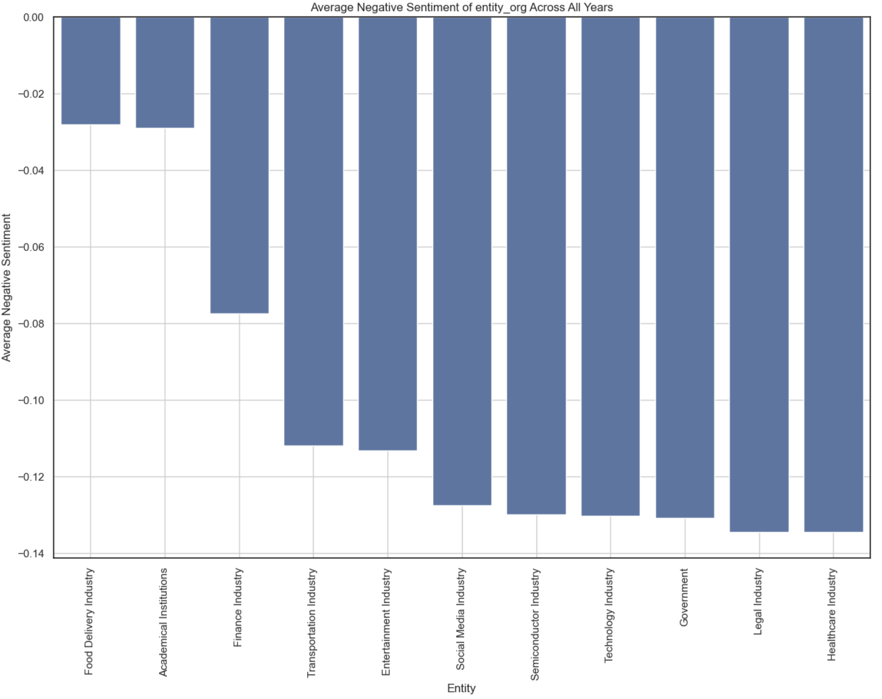
Sentiment Analysis
Sentiment customized for industry showed certain sectors with increased investment while others voiced concerns
Overall, when we customized our analysis for industry by SpaCy recognized entities to each vertical we saw that certain industries were invested for long term while some voice concerns and need for regulation:
(Positive) Semiconductor: Chip-makers like ‘NVIDIA’ and ‘TSMC’ saw a positive article mentions as the need for AI chips rose in last 2 years. They will continue to make high investment in AI and releasing better energy efficient chips.
(Positive) Finance: Finance companies were ecstatic with the surges in AI companies and stock trades, we saw a lot of articles discussing price, earnings, and nasdaq. Separately they are also invested in AI for high volume stock trading.
(Negative) Government: Government agencies voiced negative sentiment as they grappled with the challenges in regulating AI and concerns about surveillance, job displacement, and ethical implications of AI which have led them to take critical stance on AI’s rapid advancement.
(Negative) Legal: Legal industry is concerned about the potential disruption AI could cause with negative sentiment around AI replacing certain legal jobs, such as paralegals or contracts, and voiced concerns around fairness of AI in legal decisions.

Slide 11
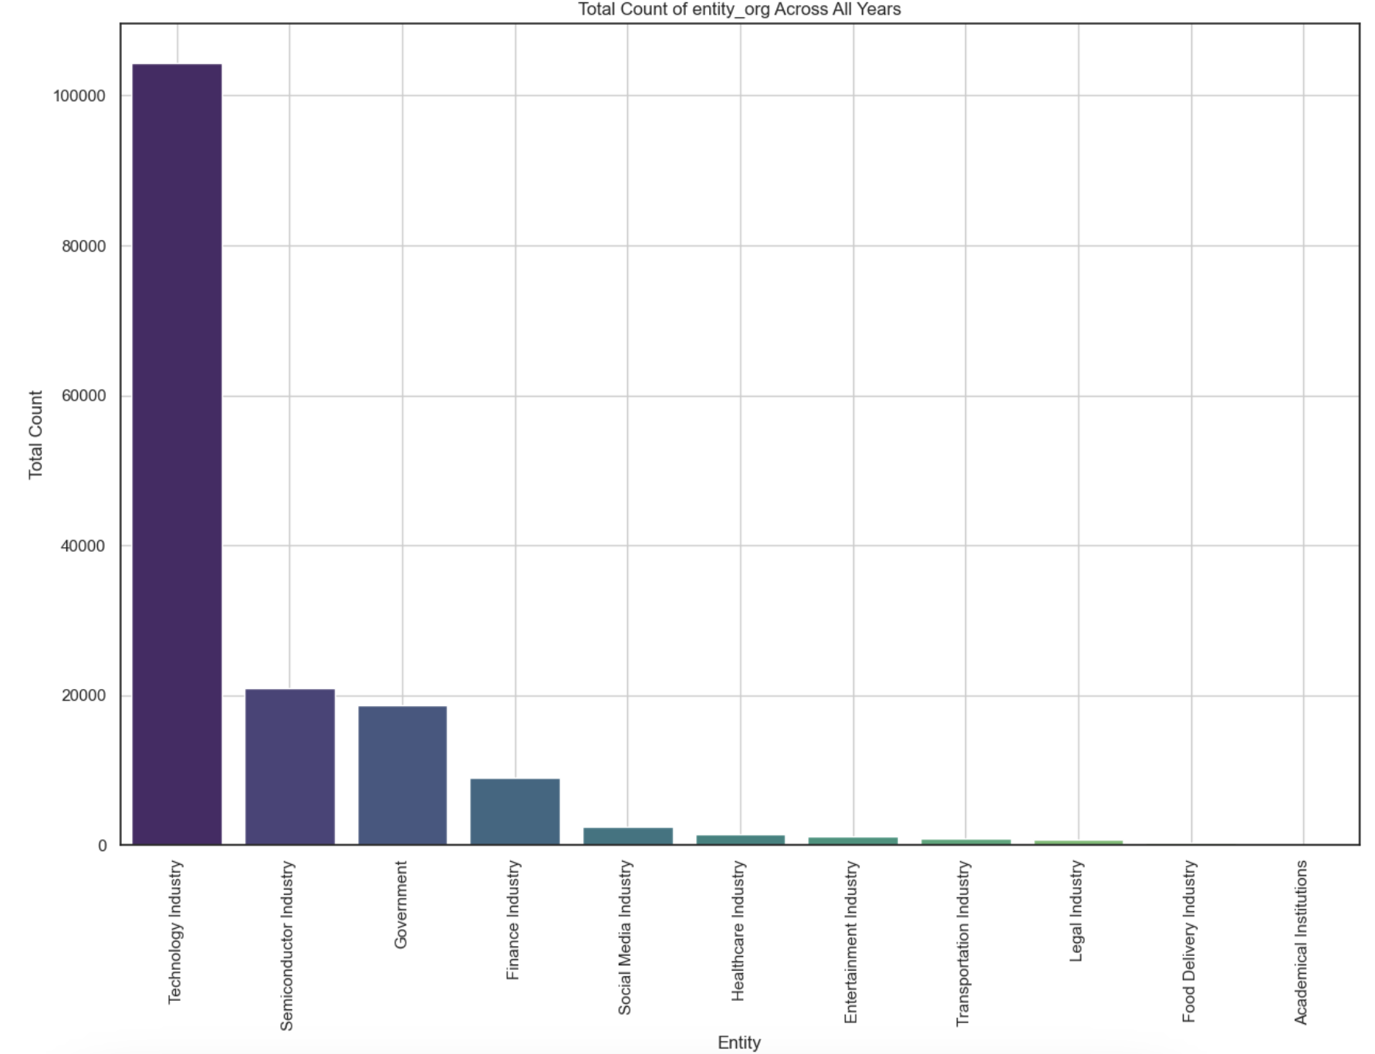
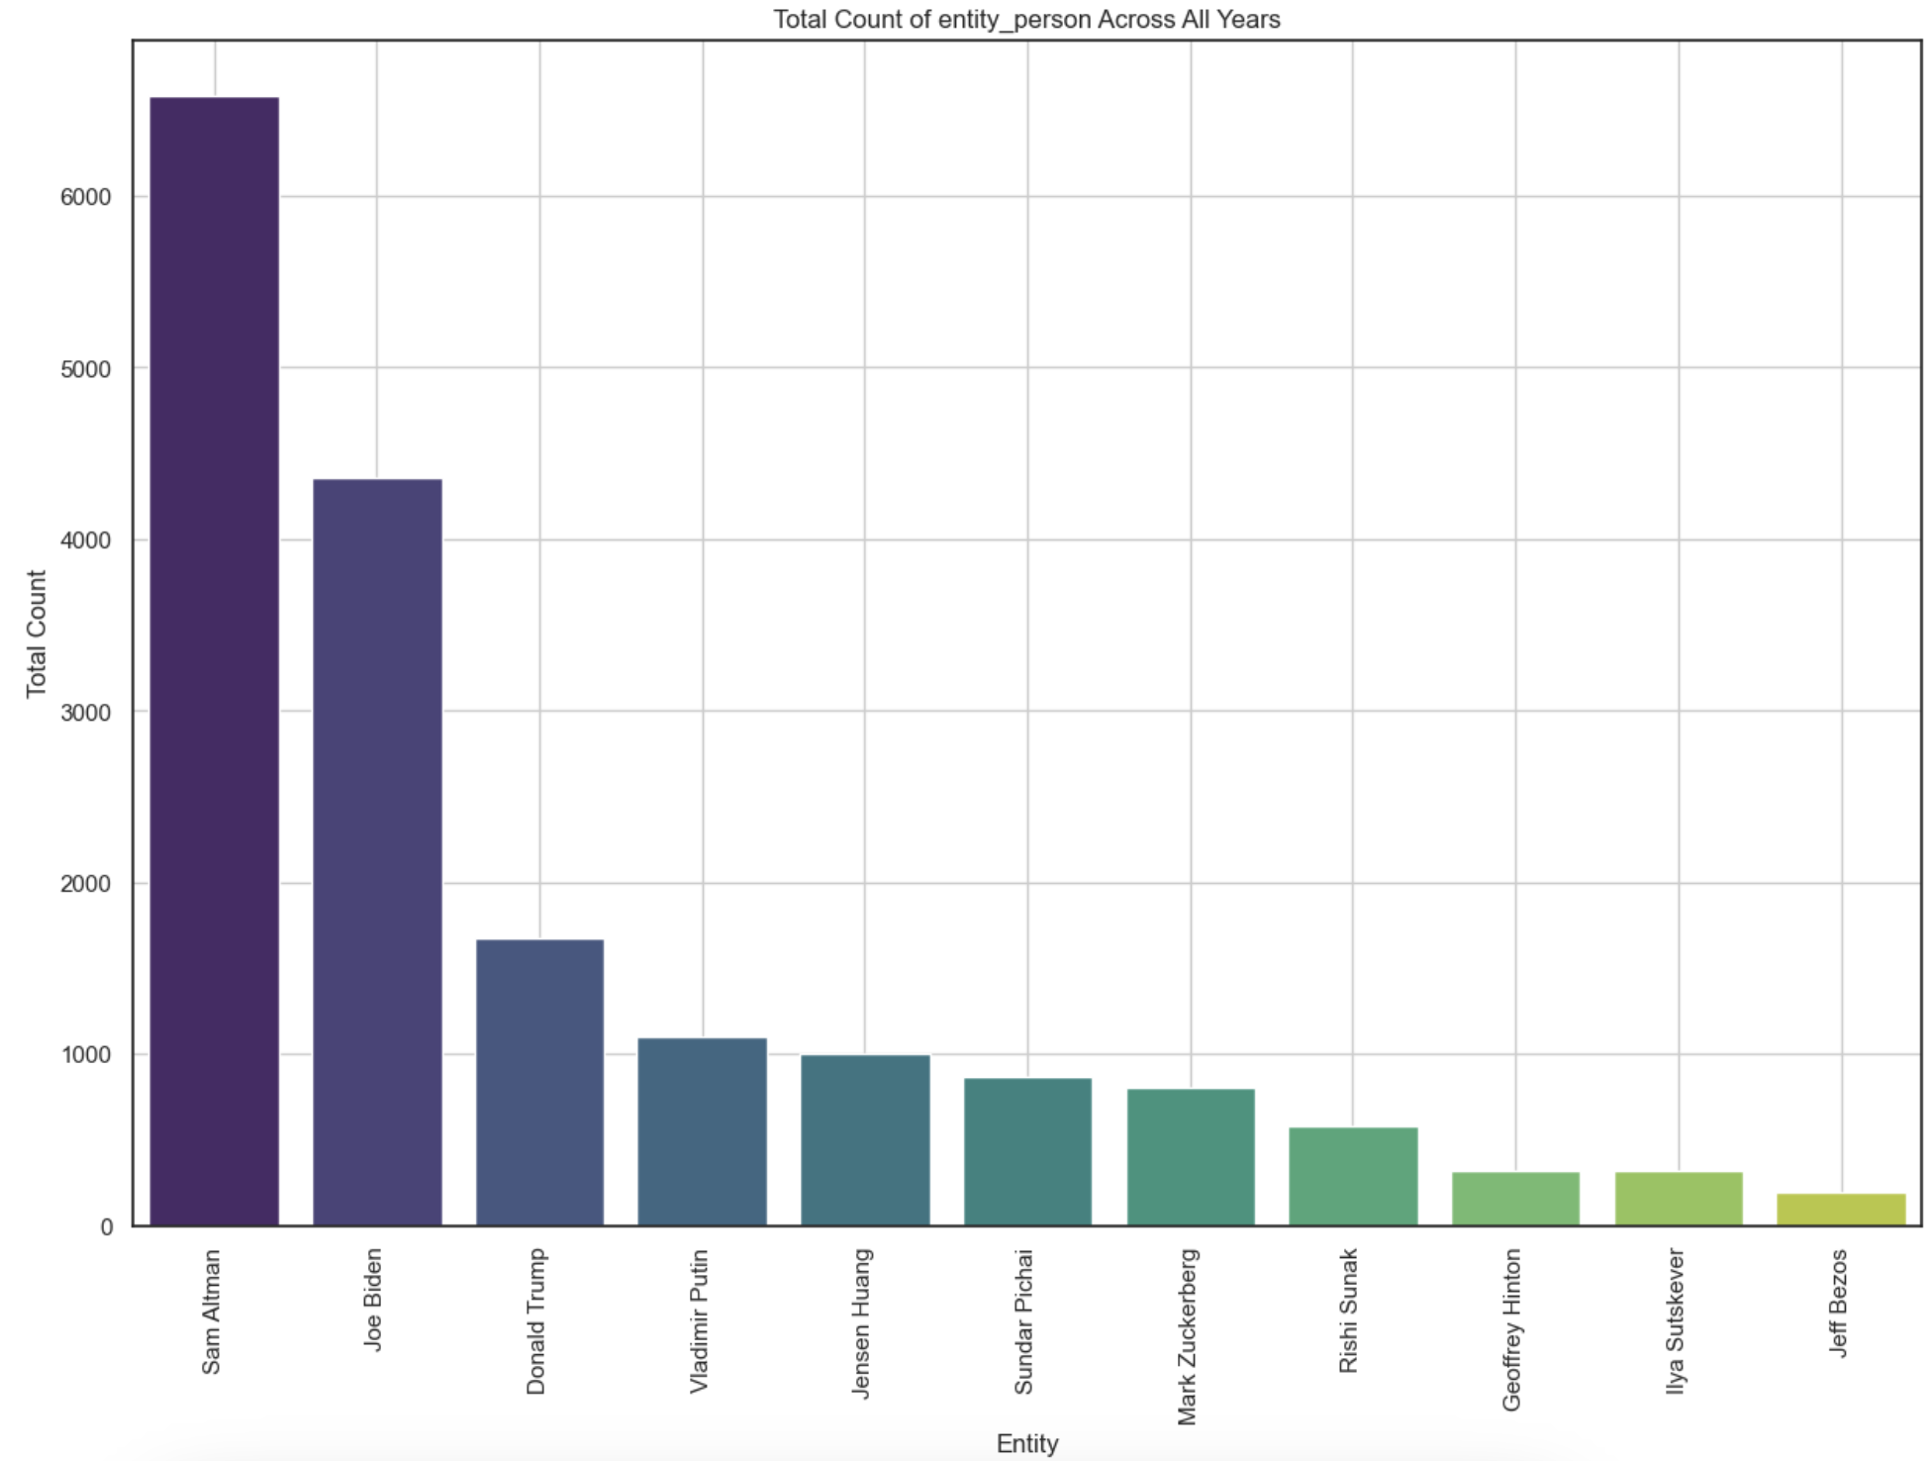
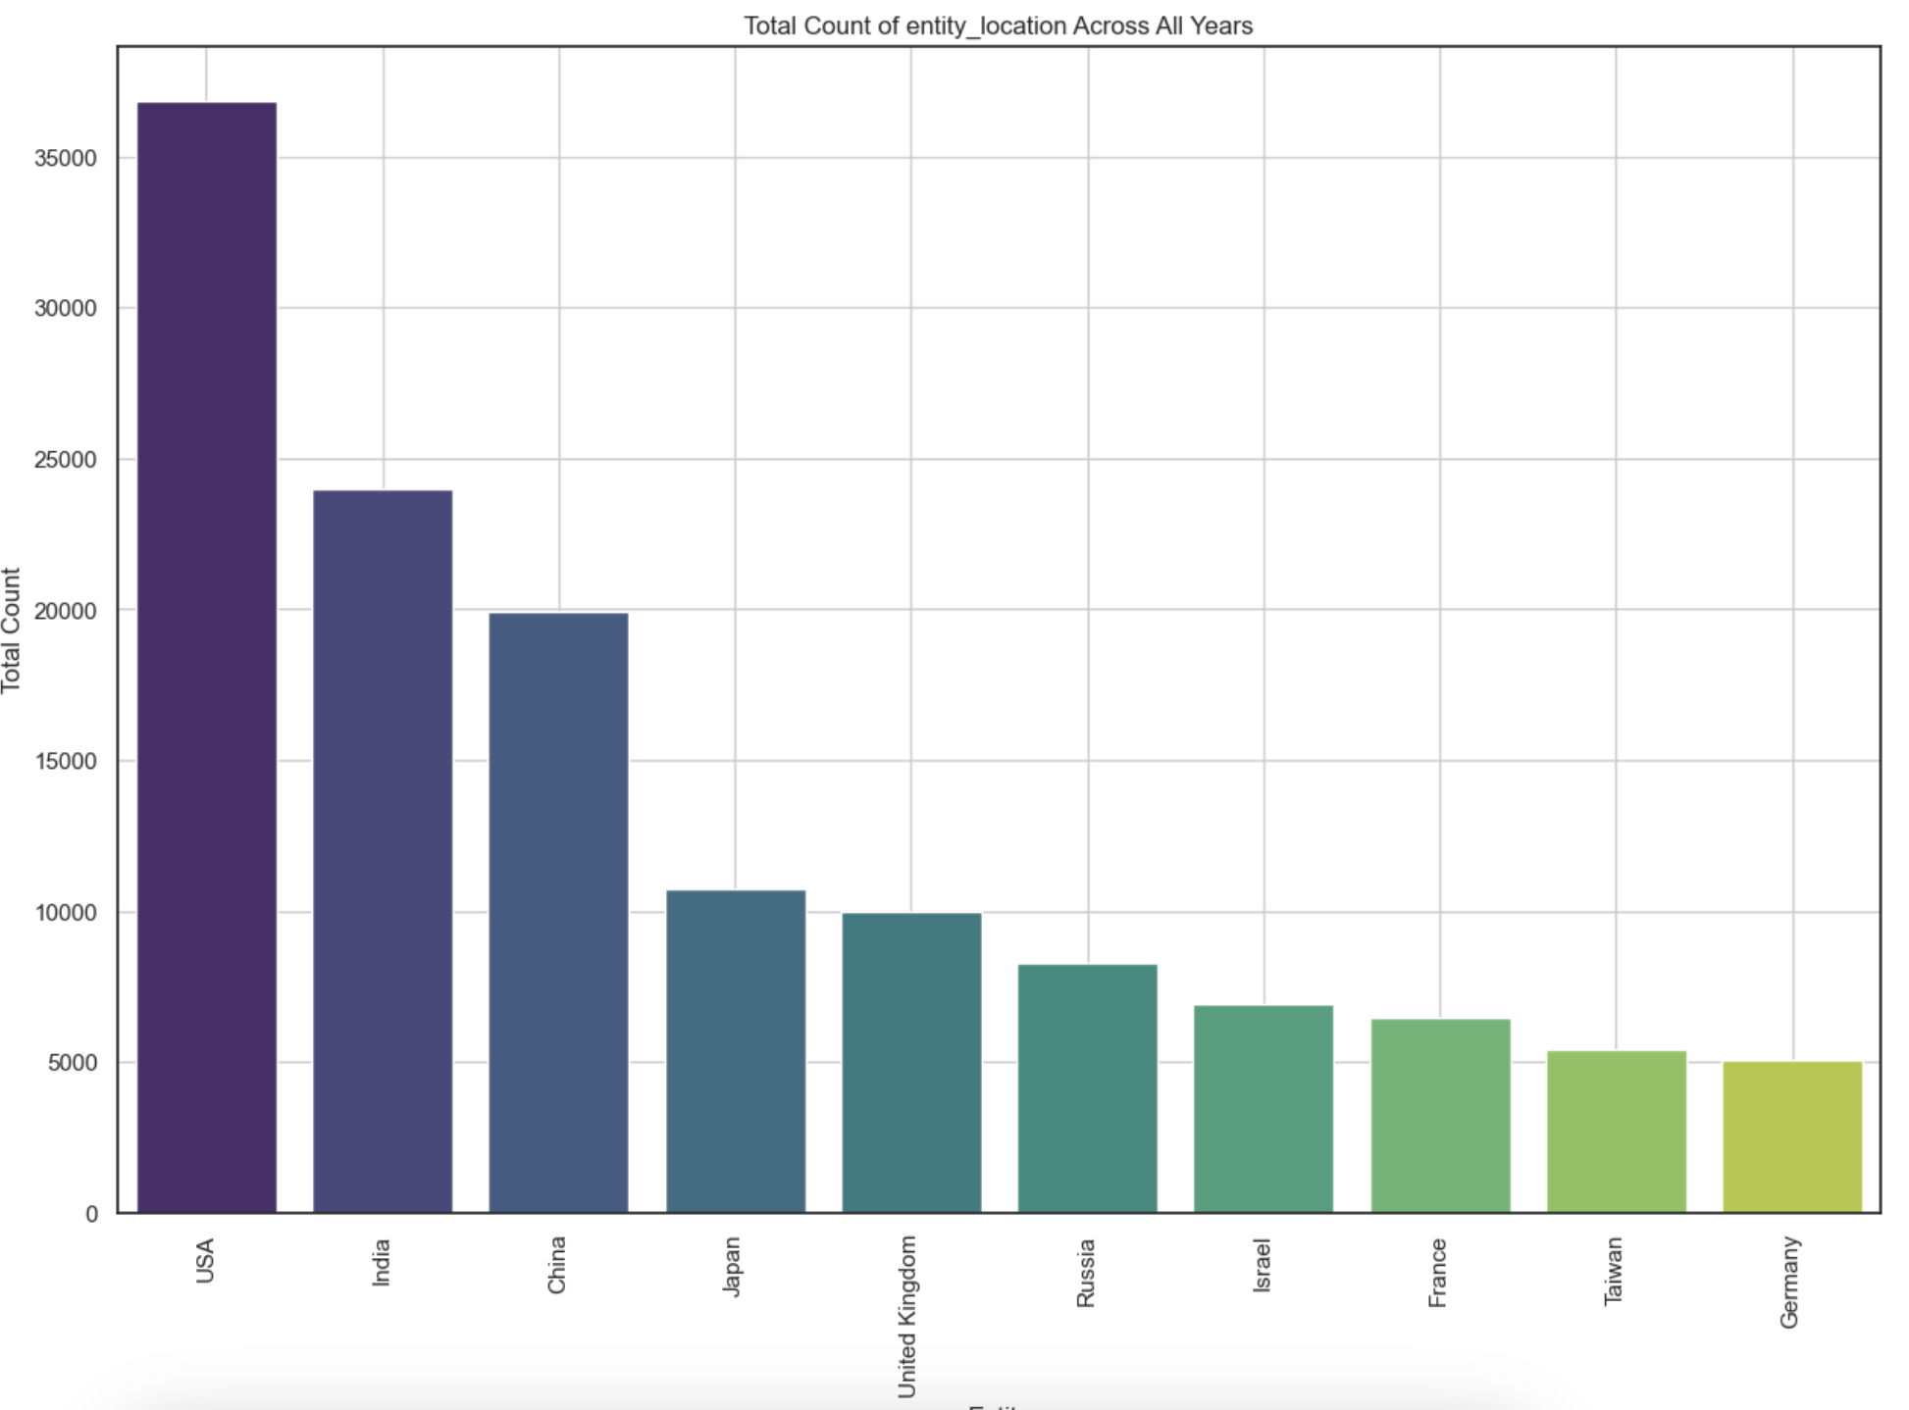
Entity Identification
Entities were identified across different types and how involved and invested they are overall
ORG (Industry)
We were able to identify different industries and saw that Technology sector (Google, OpenAI) had the maximum mentions across articles following with Semiconductor (Nvidia), Government (Congress), and then Finance (Morgan Stanley)
PER (Persons)
We were able to identify different persons and their mentions in AI related news articles like Technology leaders (Sam Altman, Sundar Pichai, Mark Zuckerberg) as well as some Politicians (Joe Biden, Trump, Putin)
LOC (Countries)
We were able to identify different locations and countries that were mentioned across articles. US lead engagement in AI related topics with India close 2nd, China 3rd and then followed by Japan.

Slide 12
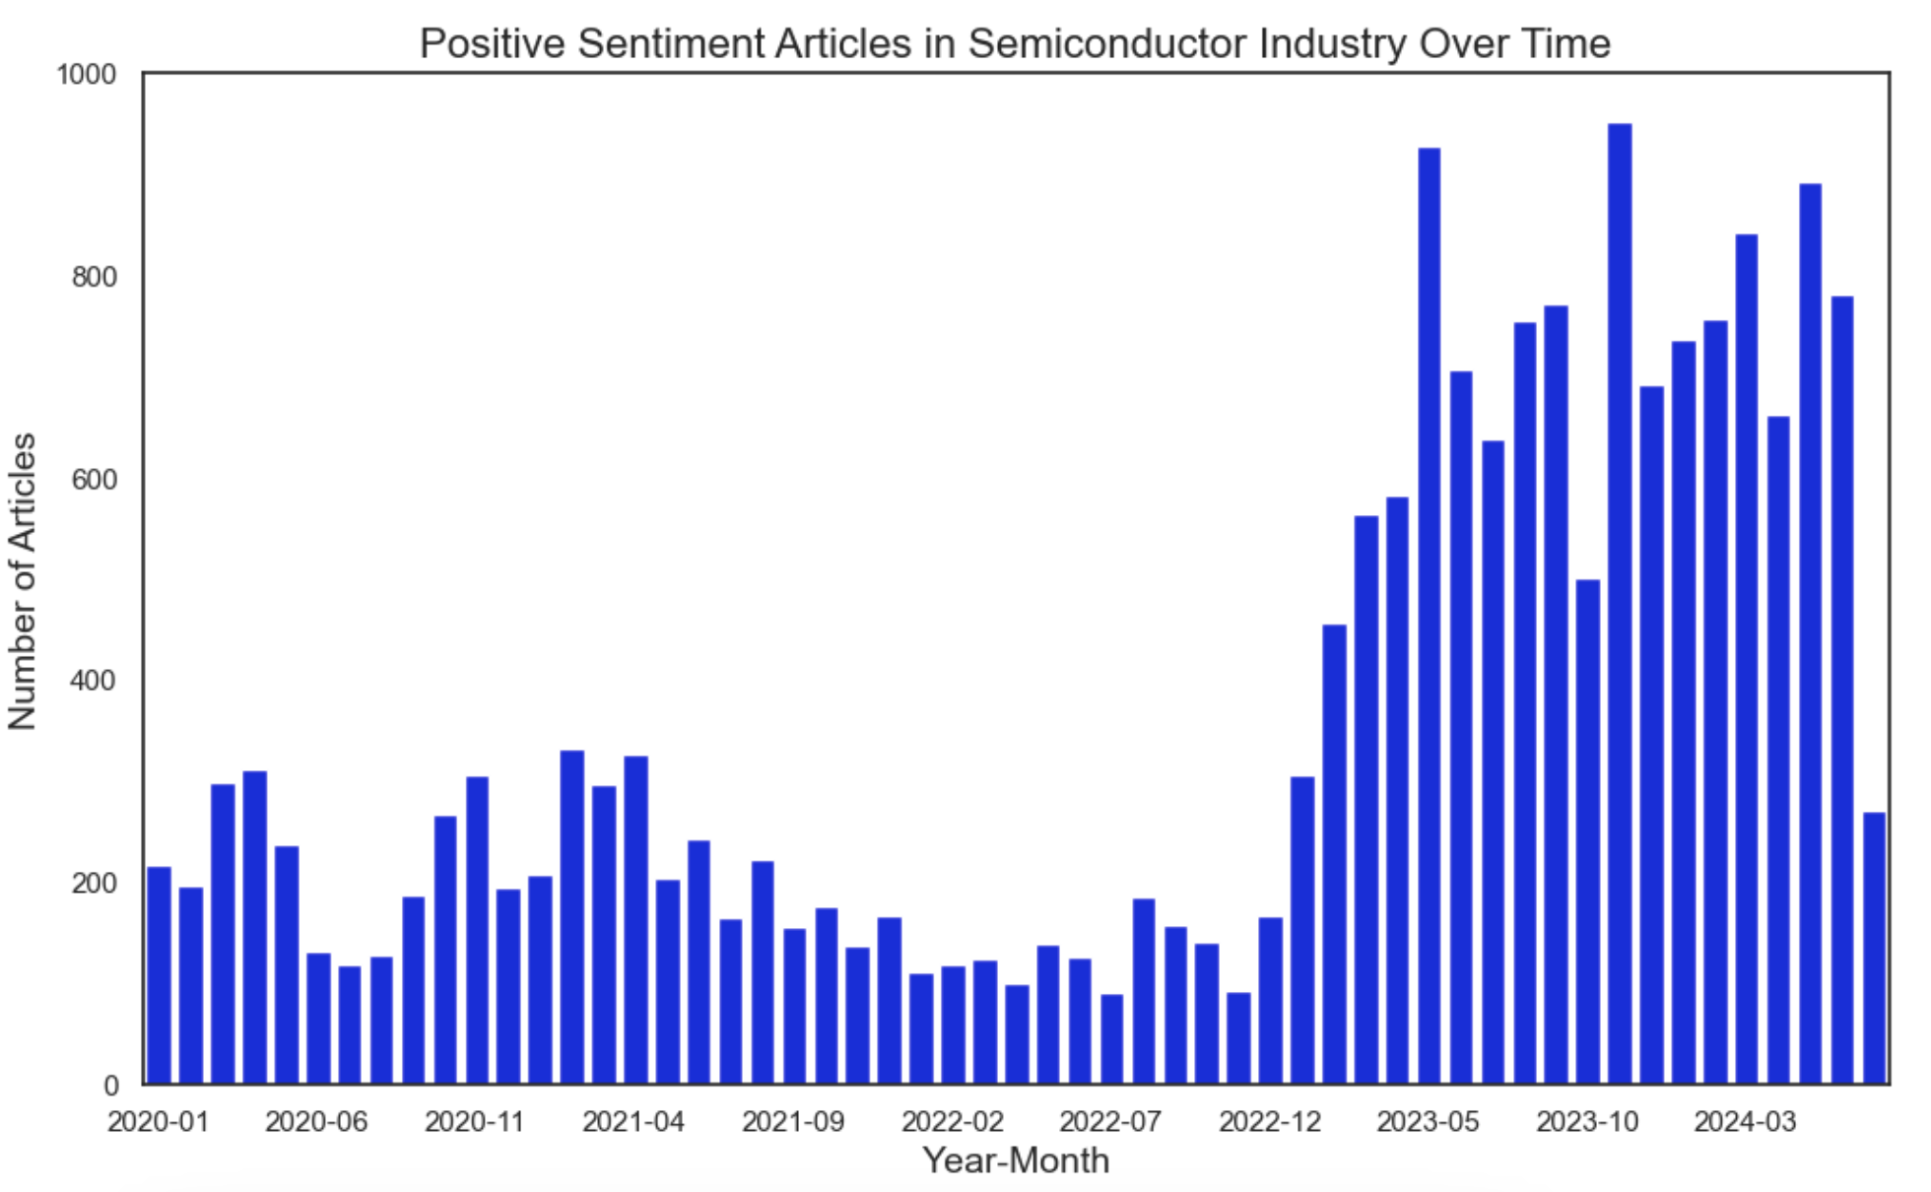
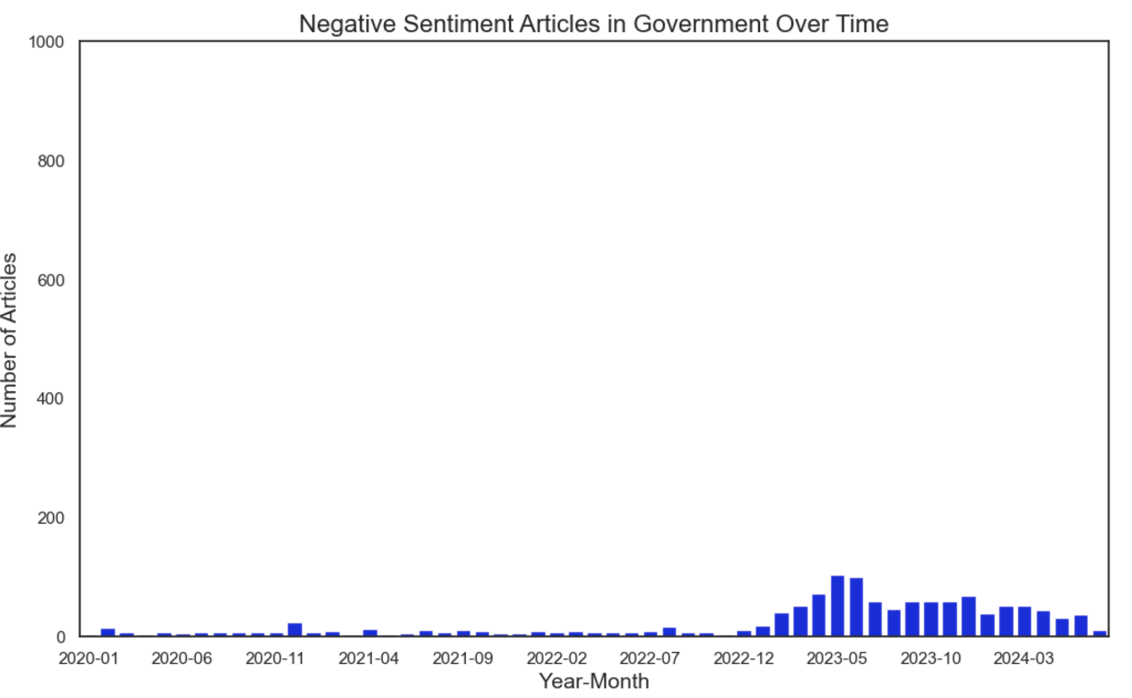
Targeted Sentiment Analysis
Targeted Sentiment Analysis applied to industries shows how investment and concern are imbalanced
As you can see there was a huge influx of investment and article mentions post launch of ChatGPT and other generative AI tools and positive sentiment articles have grown with time. This amount over-encompasses the negative sentiment articles mentioning Government agencies and how they are voicing concerns about job displacement and need for regulation. Overall in my opinion small areas will see job displacement but more areas will see increased productivity through usage of AI in day-to-day tasks at least that’s the story I go to sleep at night with.

Slide 13
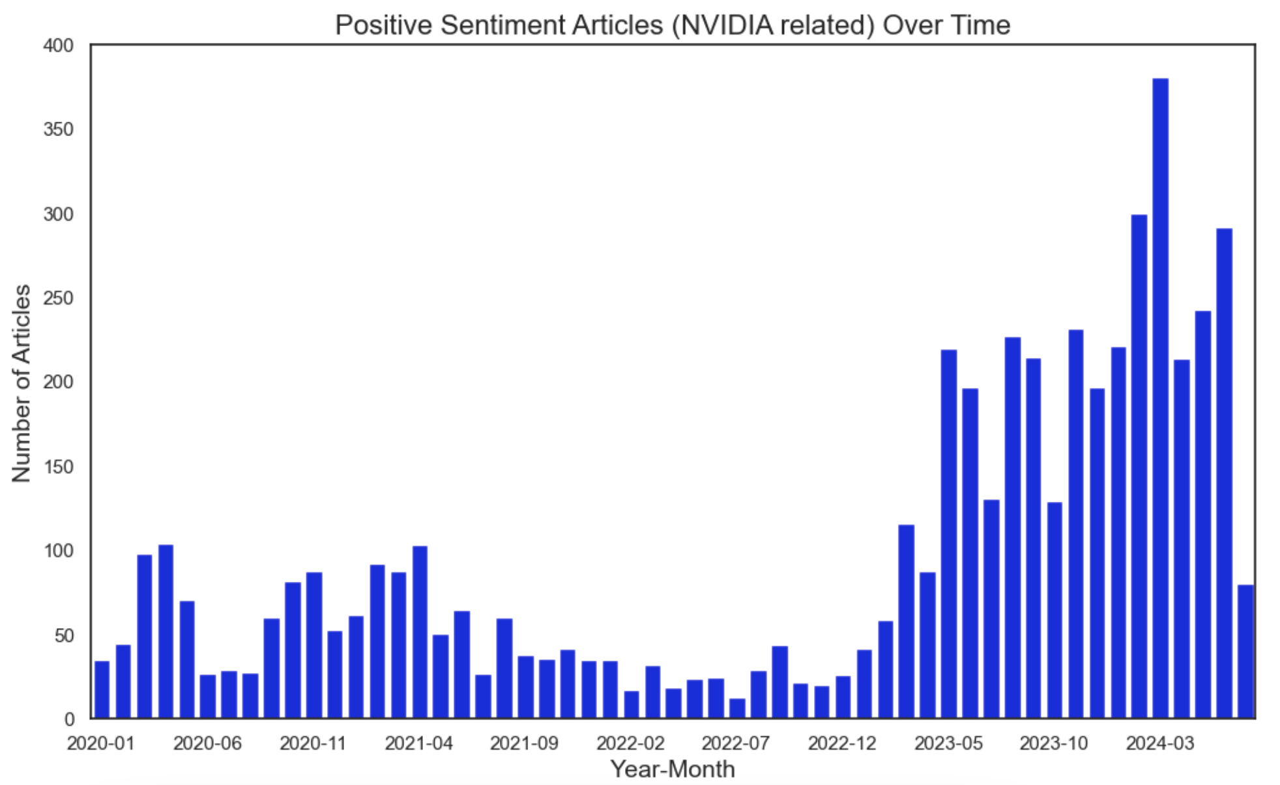
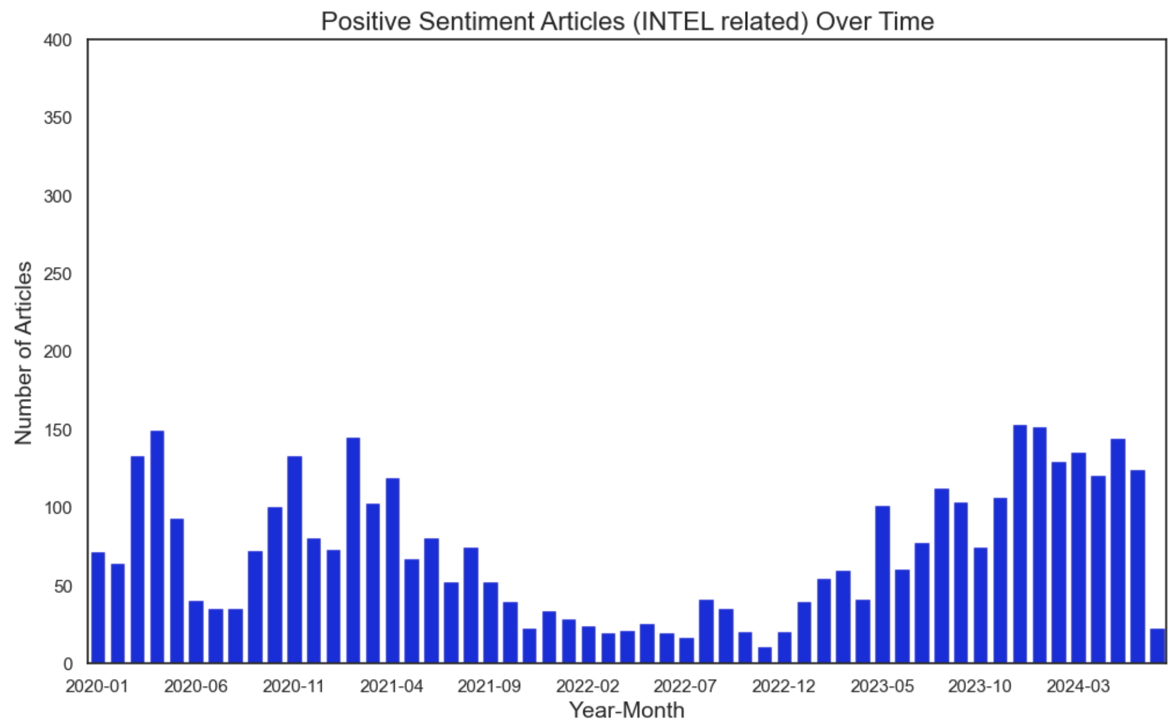
Targeted Sentiment Analysis
Another targeted analysis show how the difference between NVIDIA and Intel in AI related articles over time
For another example we came to see recently how Intel shares tanked and dropped low and I was interested to explore how AI related articles count compared for Nvidia (which saw huge uptick in its stock and demand) vs Intel - and as seen above though both companies started with same investment and article mentions the rise in AI models like ChatGPT spike Nvidia related articles. Nvidia was able to shift their chip design to service AI at a faster pace and Intel was caught asleep. This goes to show how targeted sentiment can help us figure out which companies will be successful in transition with time.

Slide 14
Thank You!

